Slide 1
LEAD SCORE CASE STUDY Group Members: Sumanth Addagalla Parv Patawari

Slide 2
Problem Statement
X Education sells online courses to industry professionals
X Education gets a lot of leads, its lead conversion rate is very poor. For example, if, say, they acquire 100 leads in a day, only about 30 of them are converted.
To make this process more efficient, the company wishes to identify the most potential leads, also known as ‘Hot Leads’.
If they successfully identify this set of leads, the lead conversion rate should go up as the sales team will now be focusing more on communicating with the potential leads rather than making calls to everyone.
Business Objective:
X wants to know most promising leads.
X Education company needed a model which identifies the hot leads
Deployment of the model for further use.

Slide 3
Solution Methodology
Collecting and Cleansing the data
One Hot Encoding
Building the train model
Feature Scaling
Feature Elimination
Confusion Matrix and Accuracy
Metrics Beyond Accuracy
Plotting ROC Curve
Finding Optimal Cut-off Point
Precision And Recall
Precision And Recall Trade Off
Making Predictions on Test Data

Slide 4
Collecting and Cleansing the data
Reading the data from CSV file and analysing the data through Jupyter
python notebook
Checking the data structure and data.
Identifying the numerical and categorical columns.
Checking the null values in columns.
Dropping the null values in the columns , where value count is greater than 3000.
Identifying the unnecessary columns (columns without variance and columns with 50% ‘select’ values) which wont help in building the model.
Dropping the unnecessary columns.

Slide 5
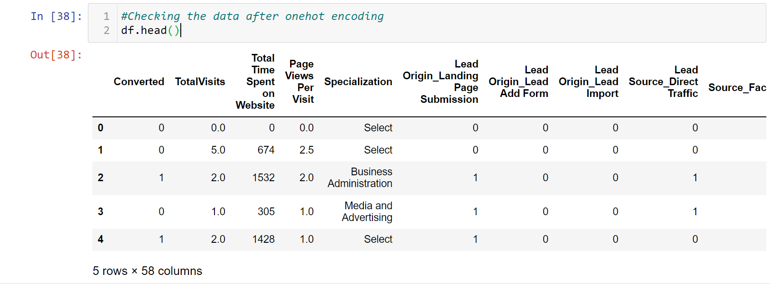
One-Hot Encoding
Identifying the categorical columns and performing the one-hot encoding on all categorical columns.
Code for performing One-Hot encoding.
After one encoding all the categorical data converted as below.

Slide 6
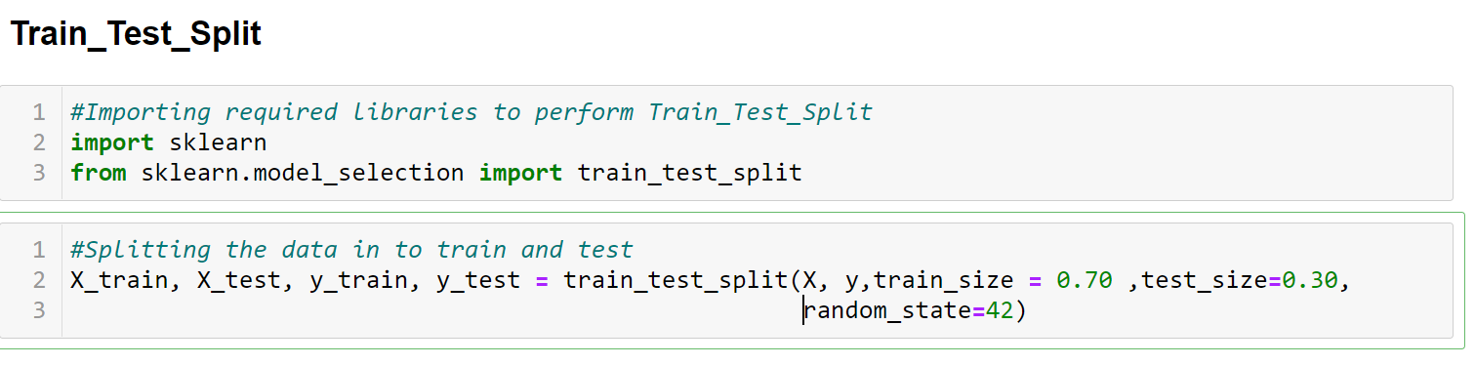
Building the Model
Dividing the data in to x and y variables.
X consists of all variables except the response variable.
Y consists of only response variable.
By Importing the python scikit learn module we split the data into Train and Test in 70:30 ratio.
Code for performing the Train Test Split Model.

Slide 7
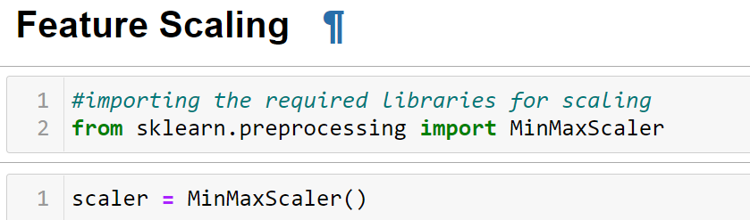
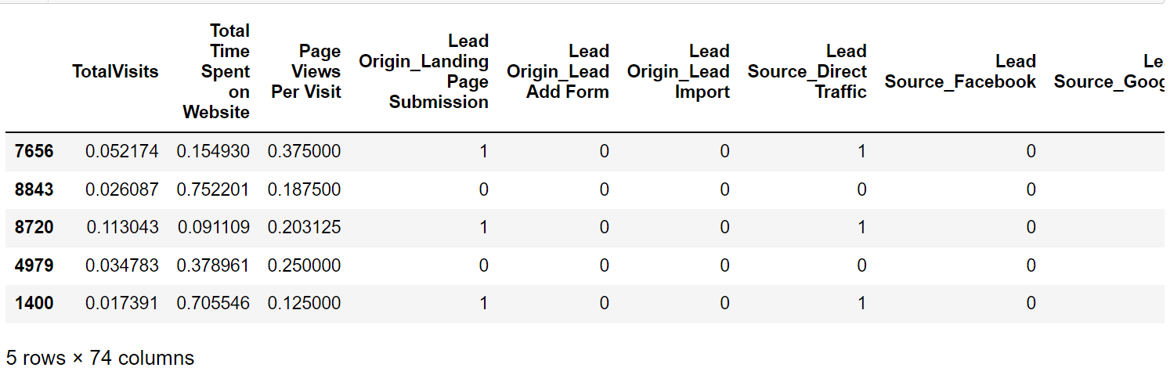
Feature Scaling
Feature scaling is a method used to normalize the range of independent variables or features of data.
We are performing Minmax scaling/Normalization in our current model to help all the data to be in the same range, for example- in the range (0,1)
Code for feature scaling
After normalization all the data in the data frame is converted in to (0,1) range.

Slide 8
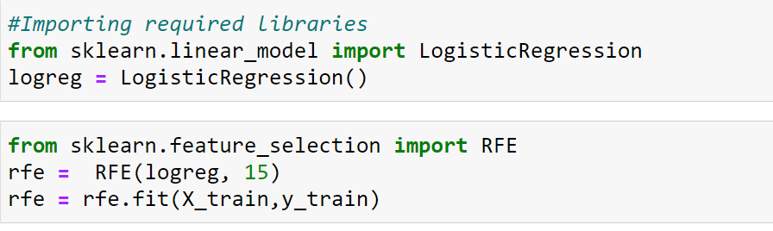
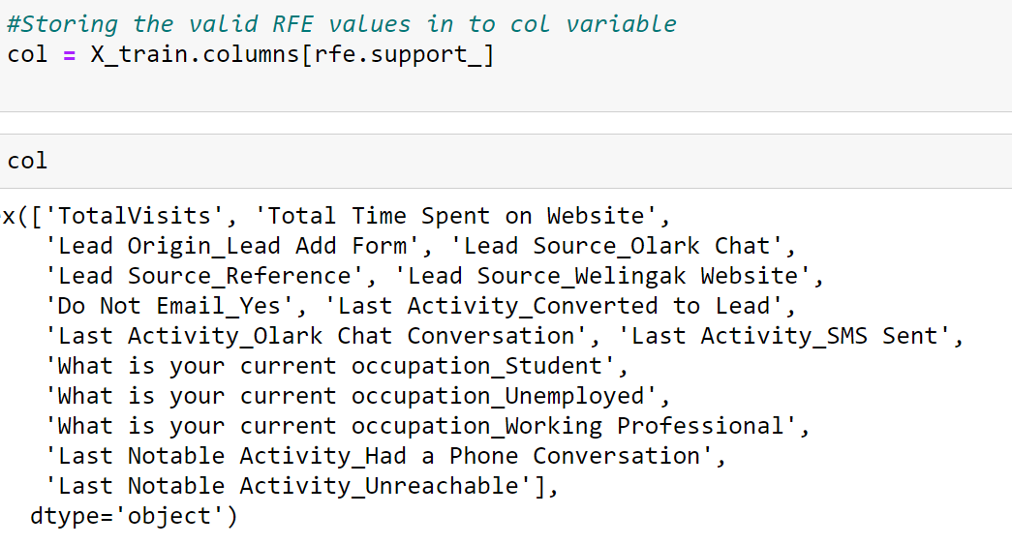
Feature Elimination Using RFE
Feature Elimination Technique RFE is useful to filter out the columns from the vast data frame.
In RFE user need to select the count, number of columns needed from RFE to proceed further with model
In current model we considered 15 columns in RFE for model building.
Code for performing RFE in python Columns filtered after RFE
We proceed further with the filtered columns form RFE in building model.

Slide 9
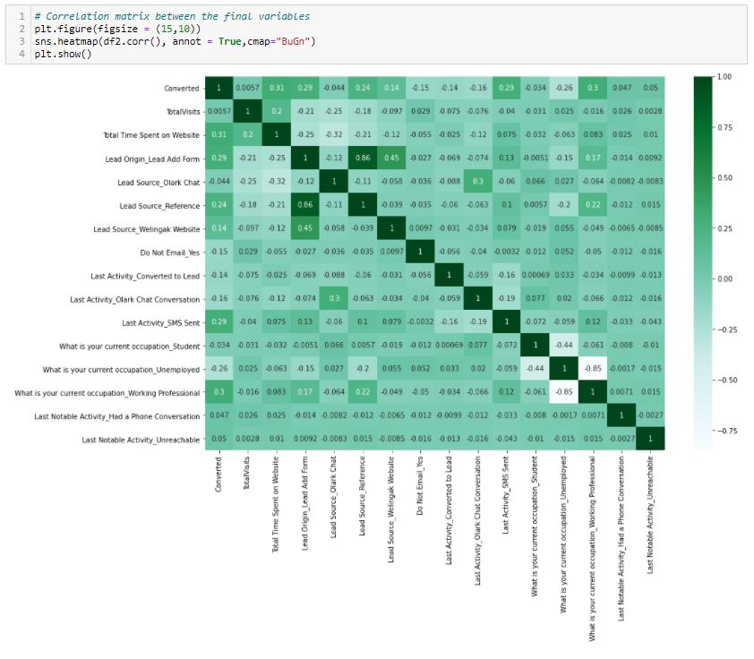
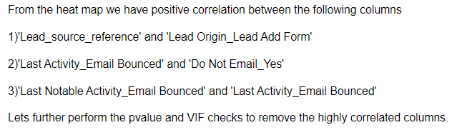
Checking the correlation
Checking the correlation we have plotted heat map on RFE filtered columns .

Slide 10
Feature Elimination Using VIF and P-value
After getting RFE filtered columns, we would start building the model with columns.
Later we check for p-value from the model and we calculate the VIF for all the columns.
Based on p-value and VIF values we eliminate the unnecessary columns.
The process of p-value and VIF continues till we get the lower p-values and VIF lesser than zero(0).
Once we got the lower p-values and VIF lesser than zero. We can finalize the columns for final model.

Slide 11
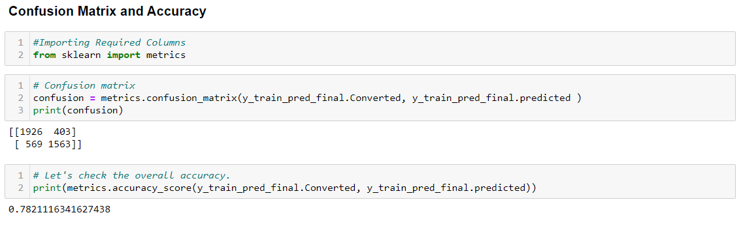
Confusion Matrix and Accuracy
After finalizing the columns form P-value and VIF.
We generate the predicted values from final data frame.
We create a new data frame with actual and predicted probabilities and new column called 'predicted' with 1 if conversion_prob >0.5 else 0.
By default we consider conversion probability as 0.5 for initial model building.
Later we use confusion matrix and generate the accuracy form the model if we get greater than 75% it’s a decent model
Later we check for sensitivity, positive predictive value and negative predictive value.
Code for checking confusion matrix and accuracy

Slide 12
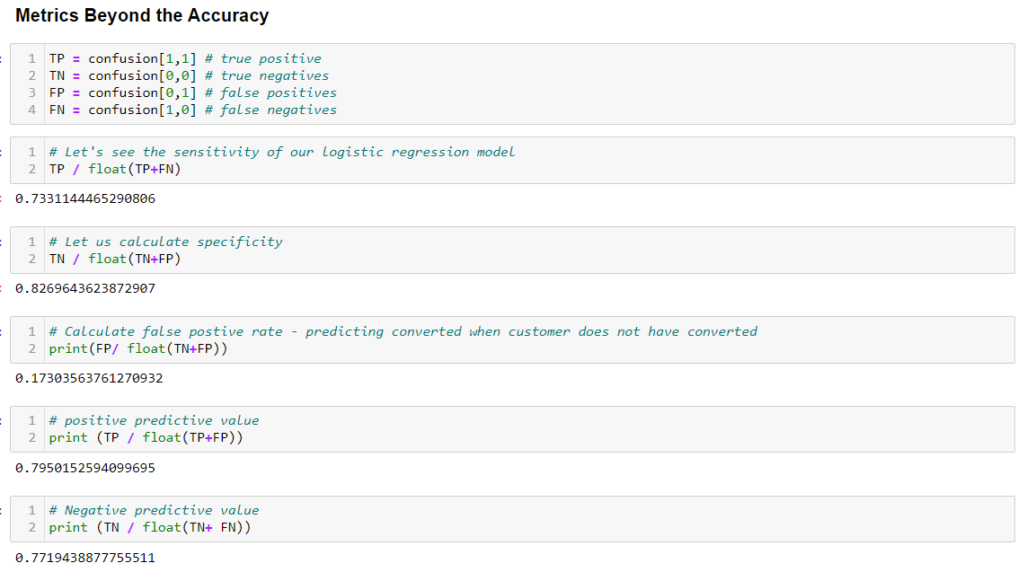
Metrics Beyond Accuracy
We cross check with other metrics other than accuracy just to validate the model.

Slide 13
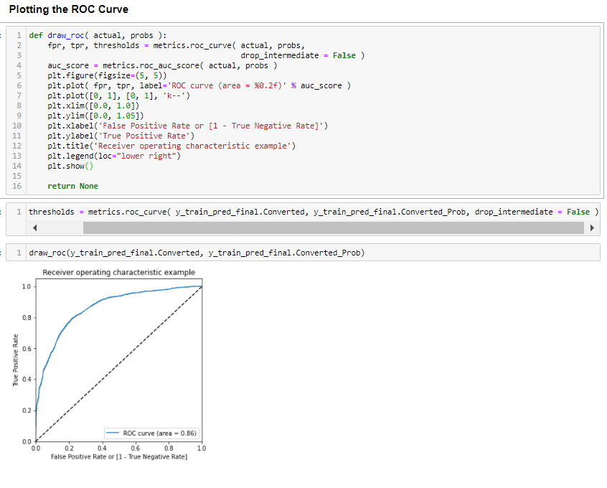
Plotting the ROC Curve
The Receiver Operator Characteristic (ROC) curve is an evaluation metric for binary classification problems. It is a probability curve that plots the TPR against FPR at various threshold values and essentially separates the 'signal' from the 'noise’.
Code for calculating the ROC:

Slide 14
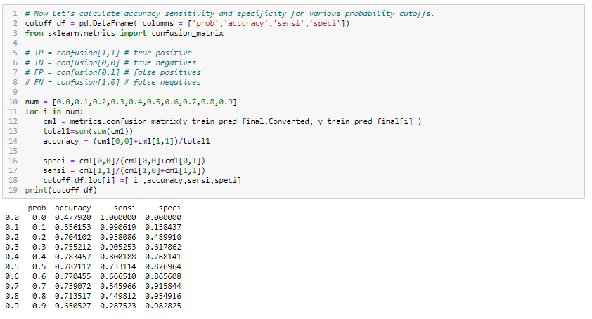
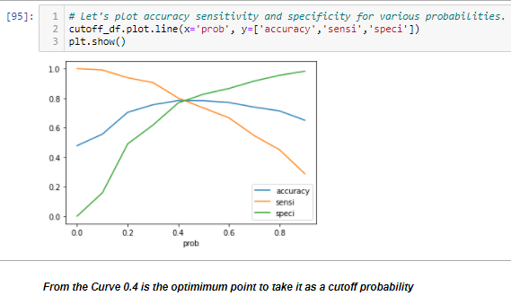
Finding Optimal Cut-off Point
Optimal cut-off probability is that probability where we get balanced specificity and sensitivity.
From the cutoff point graph above we got 0.4 as the optimum point.

Slide 15
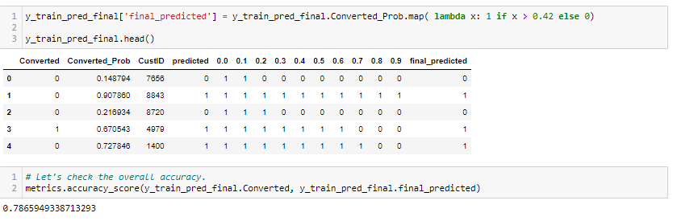
Finding Optimal Cut-off Point
After getting 0.4 as the optimum cut off point.
We need to check the accuracy considering cut off point (0.4).Where it would be the final model.
In our case we got 78% accuracy from train set .

Slide 16
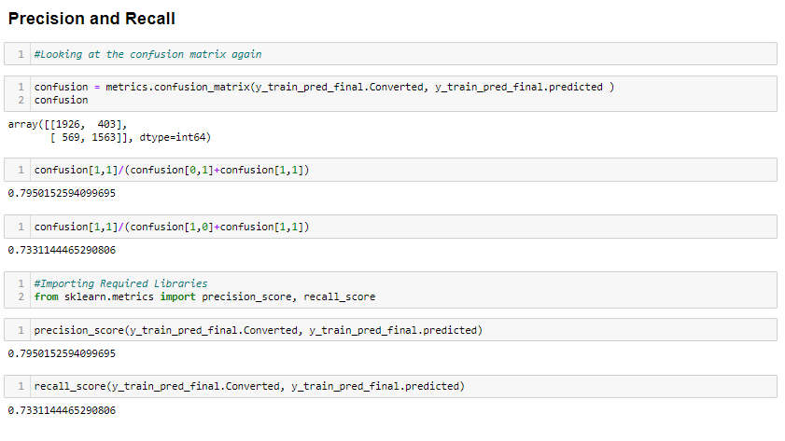
Precision and Recall
This method was also used to recheck and a cut off of 0.42 was found with Precision around 73% and recall around 79% on the test data frame.
Hence we continued with the same cut off to predict the on the test data set

Slide 17
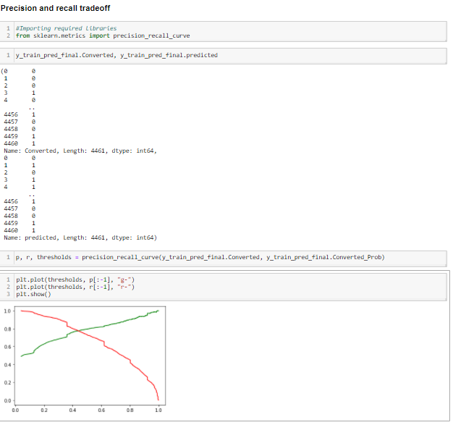
Precision and Recall Trade Off

Slide 18
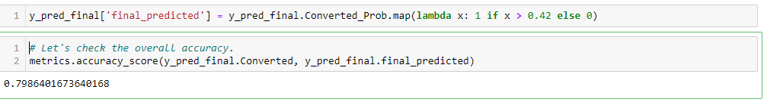
Making Predictions On Test Data
After we get finalized the train model and accuracy.
Further we consider the same variables from train data set and test on the test data
We again scale the variables on test data and generate the predicted values on test set.
With the final cut off point 0.42 we calculate an accuracy on test data.
The accuracy on test data should be near by or more than the accuracy of train data.
Where we achieved the accuracy on test data as 79%

Slide 19
CONCLUSION
Hence we made a Logistic Regression model having an accuracy around 80%.
From the above model the X company can focus on the leads which can convert and increase their sales accordingly rather wasting their resource on less converting leads.
THANK YOU

